Slide 1

Regular Language, Context Free Grammars, Pushdown Automaton (PDA), Turing Machine

Slide 2
Regular languages
As already been discussed earlier that any language that can be expressed by a RE is said to be regular language,
so if L1 and L2 are regular languages then
L₁ + L₂ , L₁L₂ and L₁* are also regular languages.
This fact can be proved by the following two methods

Slide 3
(1) By Regular Expressions
As discussed earlier that if r₁, r₂ are regular expressions, corresponding to the languages L₁ and L₂ then the languages L₁ + L₂ , L₁L₂ and L₁* generated by r₁+ r₂, r₁r₂ and r₁*, are also regular languages.
(2) By TGs
If L₁ and L₂ are regular languages then L1 and L2 can also be expressed by some REs as well and hence using Kleene’s theorem, L₁ and L₂ can also be expressed by some TGs.

Slide 4
Complement of a language
Let L be a language defined over an alphabet Σ, then the language of strings, defined over Σ, not belonging to L, is called Complement of the language L, denoted by L^{c} or L’.

Slide 5
Note
To describe the complement of a language, it is very important to describe the alphabet of that language over which the language is defined.
For a certain language L, the complement of L^{c} is the given language L i.e. (L^{c})^{c} = L

Slide 6
Theorem
If L is a regular language then, L^{c} is also a regular language.
Proof
Since L is a regular language, so by Kleene’s theorem, there exists an FA, say F, accepting the language L. Converting each of the final states of F to non-final states and old non-final states of F to final states, FA thus obtained will reject every string belonging to L and will accept every string, defined over Σ, not belonging to L. Which shows that the new FA accepts the language L^{c} . Hence using Kleene’s theorem L^{c} can be expressed by some RE. Thus L^{c} is regular.

Slide 7
Theorem
Statement
If L₁ and L₂ are two regular languages, then L₁ ח L₂ is also regular.
Proof
Using De-Morgan's law for sets
(L₁^{c} U L₂^{c} )^{c} = (L₁^{c})^{c} ח (L₂^{c}) ^{c} = L₁ ח L₂
Since L₁ and L₂ are regular languages, so are L₁^{c} and L₂^{c}. L₁^{c} and L₂^{c} being regular provide that
L₁^{c} U L₂^{c} is also regular language and so (L₁^{c} U L₂^{c})^{c} = L₁ ח L₂ , being complement of regular language is regular language.

Slide 8
Nonregular languages
The language that cannot be expressed by any regular expression is called a Nonregular language.
The languages PALINDROME and PRIME are the examples of nonregular languages.
Note: It is to be noted that a nonregular language, by Kleene’s theorem, can’t be accepted by any FA or TG.

Slide 9
Context Free Grammar (CFG)
The high level language is converted into assembly language codes by a program called compiler.
The compiler that takes the user’s programs as its inputs and prints out an equivalent program written in assembly language.
Like spoken languages, high level languages for computer have also, certain grammar. But in case of computers, the grammatical rules, don’t involve the meaning of the words.

Slide 10
CFG continued …
It can be noted that the grammatical rules which involve the meaning of words are called Semantics, while those don’t involve the meaning of the words are called Syntactics. e.g. in English language, it can not be written “ Buildings sing ”, while in computer language one number is as good as another. e.g. X = B + 10, X = B + 999
Following is a remark

Slide 11
Remark
In general, the rules of computer language grammar, are all syntactic and not semantic.
A law of grammar is in reality a suggestion for possible substitutions.

Slide 12
CFG terminologies
Terminals: The symbols that can’t be replaced by anything are called terminals.
Non-Terminals: The symbols that must be replaced by other things are called non-terminals.
Productions: The grammatical rules are often called productions.

Slide 13
CFG
CFG is a collection of the followings
An alphabet ∑ of letters called terminals from which the strings are formed, that will be the words of the language.
A set of symbols called non-terminals, one of which is S, stands for “start here”.
A finite set of productions of the form
non-terminal → finite string of terminals and /or non-terminals.
Following is a note in this regard

Slide 14
Note
The terminals are designated by small letters, while the non-terminals are designated by capital letters.
There is at least one production that has the non-terminal S as its left side.

Slide 15
Context Free Language (CFL)
The language generated by CFG is called Context Free Language (CFL).
Example
∑ = {a}
Productions:
S →a S
S→ Λ
Applying production (1) six times and then production (2) once, the word aaaaaa is generated as

Slide 16
Example Cont….
S → a S
→ aa S
→ aaa S
→ aaaa S
→ aaaaa S
→ aaaaaa S
→ aaaaaa S
= aaaaaa

Slide 17
Example continued …
a can be generated applying prod. (1) once and then prod. (2), aa can be generated applying prod. (1) twice and then prod. (2) and so on.
This shows that the grammar defines the language expressed by a*.

Slide 18
A new format for FAs
A class of machines (FAs) has been discussed accepting the regular language i.e. corresponding to a regular language there is a machine in this class, accepting that language and corresponding to a machine of this class there is a regular language accepted by this machine.
It has also been discussed that there is a CFG corresponding to regular language and CFGs also define some nonregular languages, as well

Slide 19
A new format for FAs contd. …
There is a question whether there is a class of machines accepting the CFLs?
The answer is yes.
The new machines which are to be defined are more powerful and can be constructed with the help of FAs with new format.
To define the new format of an FA, the following are to be defined

Slide 20
A new format for FAs contd. …
Input TAPE
The part of an FA, where the input string is placed before it is run, is called the input TAPE.
The input TAPE is supposed to accommodate all possible strings. The input TAPE is partitioned with cells, so that each letter of the input string can be placed in each cell.
The input string abbaa is shown in the following input TAPE.

Slide 21

Input TAPE contd…
The character ∆ indicates a blank in the TAPE. The input string is read from the TAPE starting from the cell (i).
It is assumed that when first ∆ is read, the rest of the TAPE is supposed to be blank.

Slide 22

The START state
START: This state is like initial state of an FA and is represented by

Slide 23

An Accept state
ACCEPT: This state is like a final state of an FA and is expressed by

Slide 24

A REJECT state
REJECT: This state is like dead-end non final state and is expressed by
NOTE: It may be noted that the ACCEPT and REJECT states are called the halt states.

Slide 25
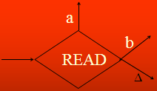
A READ state
READ: This state is to read an input letter and branch to some other state. The READ state is expressed by

Slide 26
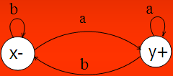
Example
Before some other states are defined consider the following example of an FA along with its new format.
Obviously the above FA accepts the language of strings, expressed by (a+b)*a. Following is the new format of the above FA

Slide 27
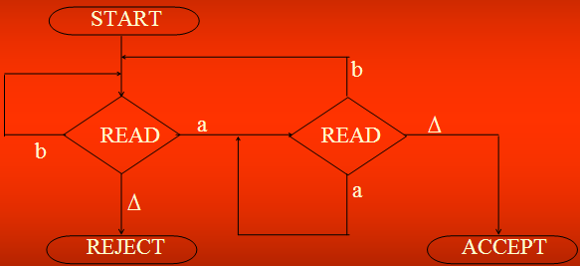
Example contd. …

Slide 28
Note
The ∆ edge should not be confused with Λ -labeled edge. The ∆-edges start only from READ boxes and lead to halt states.

Slide 29
PUSHDOWN STACK: PUSHDOWN STACK is a place where the input letters can be placed until these letters are referred again. It can store as many letters as one can in a long column. Initially the STACK is supposed to be empty i.e. each of its storage location contains a blank.
PUSH : A PUSH operator adds a new letter at the top of STACK, for e.g. if the letters a, b, c and d are pushed to the STACK that was initially blank, the STACK can be shown as

Slide 30


PUSH and STACK contd. …
The PUSH state is expressed by
When a letter is pushed, it replaces the existing letter and pushes it one position below.

Slide 31
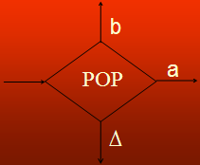
POP and STACK
POP: POP is an operation that takes out a letter from the top of the STACK. The rest of the letters are moved one location up. POP state is expressed as

Slide 32
Note
It may be noted that popping an empty STACK is like reading an empty TAPE, i.e. popping a blank character ∆.
It may also be noted that when the new format of an FA contains PUSH and POP states, it is called PUSHDOWN Automata or PDAs. It may be observed that if the PUSHDOWN STACK (the memory structure) is added to an FA then its language recognizing capabilities are increased considerably.

Slide 33
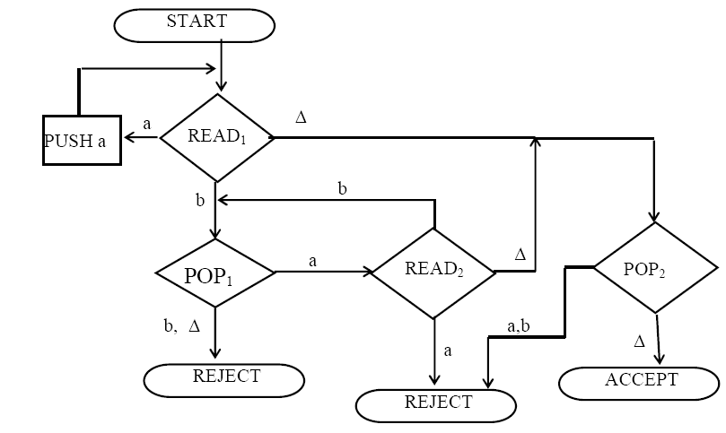
Example: Consider the following PDA

Slide 34
PUSHDOWN AUTOMATON (PDA)
Pushdown Automaton (PDA), consists of the following
An alphabet Σ of input letters.
An input TAPE with infinite many locations in one direction. Initially the input string is placed in it starting from first cell, the remaining part of the TAPE is empty.
An alphabet Γ of STACK characters.
A pushdown STACK which is initially empty, with infinite many locations in one direction. Initially the STACK contains blanks.

Slide 35
PDA Continued ...
5. One START state with only one out-edge and no in-edge.
6. Two halt states i.e. ACCEPT and REJECT states, with in-edges and no out-edges.
7. A PUSH state that introduces characters onto the top of the STACK.
8. A POP state that reads the top character of the STACK, (may contain more than one out-edges with same label).
9. A READ state that reads the next unused letter from the TAPE, (may contain more than one out-edges with same label).

Slide 36
Turing Machine
The mathematical models (FAs, TGs, PDAs) that have been discussed so far can decide whether a string is accepted or not by them i.e. these models are language identifiers.
However, there are still some languages which can’t be accepted by them e.g. there does not exist any FA or TG or PDA accepting any non-CFLs.
Alan Turing developed the machines called Turing machines, which accept some non-CFLs as well, in addition to CFLs.

